Slide 1
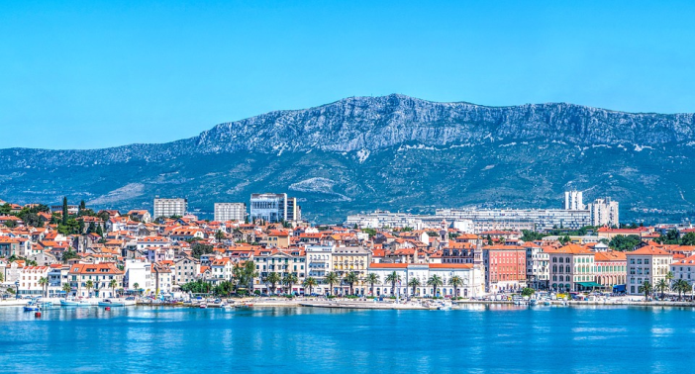
How do we live in our country?
- Modern housing

Slide 2
Introduction
Croatia has many natural wonders
It owes its prosperity to these wonders. Croatia is a country with many UNESCO sites that are worth seeing. Not only does it have crystal clear seas, it also is part of the Alps. The mountains and the Adriatic sea make for breathtaking views

Slide 3
Croatia’s architecture
Throughout history, the architecture in Croatia has undergone many changes, but it has preserved its iconic stone houses, particularly along the coast and on the islands. These ones, on the island of Šolta, were built close to one another to shield from the Bura, a strong wind.

Slide 4
Modern housing
Croatia, like many other countries today, is faced with ecology problems.
Croatia has many residential buildings that are built in the classic way that waste energy
The most significant consumption of energy goes toward heating, water heating and air conditioning.
Up to 2015, Croatia has 21 passive houses, in which residents consume up to 80% less energy for heating and cooling than in typical housing
The city of Koprivnica, with its population of 31,000, is the national leader in this kind of construction.

Slide 5
The city of Koprivnica
Koprivnica is the first city with this new housing program called „The new face of Koprivnica”
The goal of this program is to create one part of the city as a green district with low energy buildings
Buildings with A+ energy certificates
It is the winner of the Energy Globe Award in 2015.
It is also the first smart city in Croatia and seventh in Europe to have an ISO certificate
The highest level of certificate - Platinum

Slide 6
The low energy construction in Koprivnica is one of the first examples of this kind in the Republic of Croatia
Until September of 2016, three of these types of low energy buildings have been constructed
Insulation, floor and wall heating systems, solar collectors and a ventilation-controlled monitor were installed – all according to the standards for low energy buildings.
Flats range from 35 to 66 m2. Within the building, there are 28 flats with 42 parking/garage spaces, that cost a total of 1.4 million Euros
Within the same project, low energy housing was constructed called FIRST ECO SANDWICH HOUSE.
It got its name because of the facade is made from innovative concrete sandwich panels called ECO SANDWICH PANELS.

Slide 7
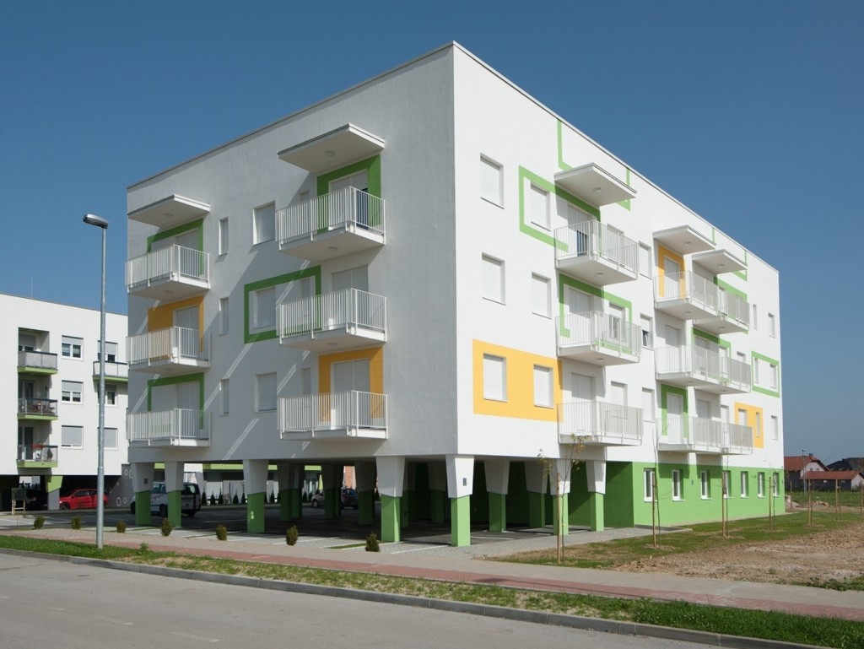
A low energy building in Koprivnica – „Šparna Hiža”

Slide 8
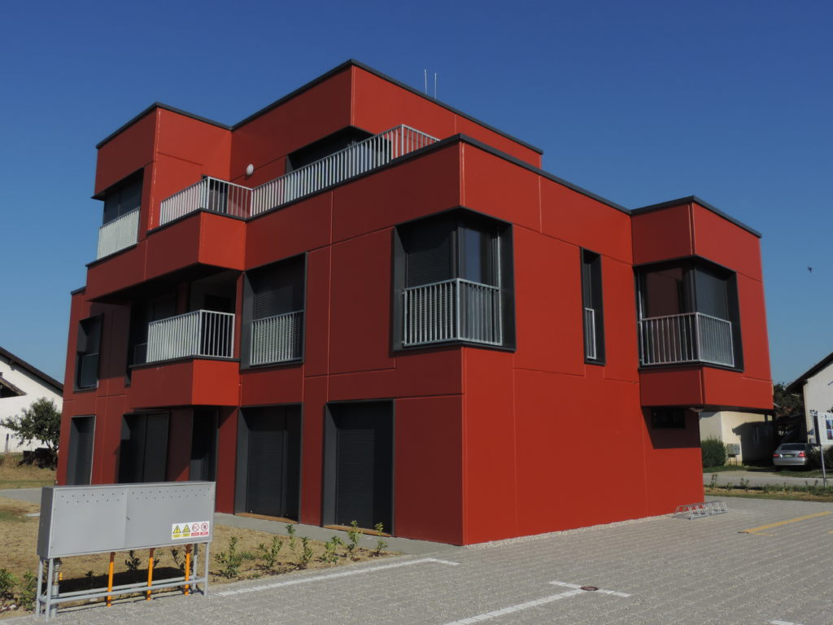
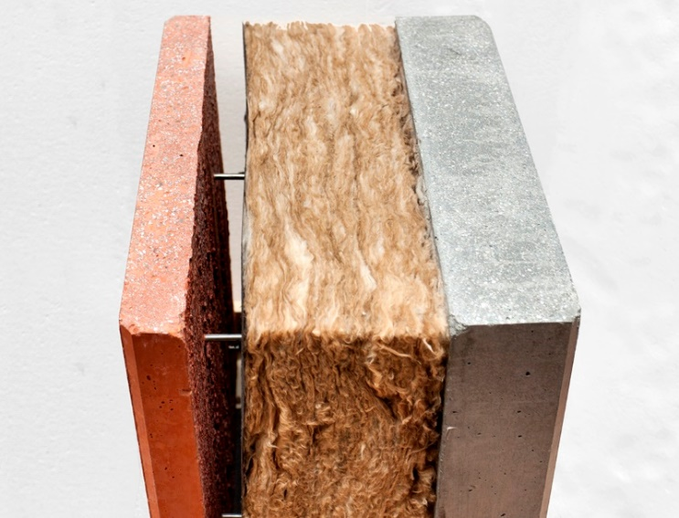
„First eco sandwich” house in Koprivnica

Slide 9
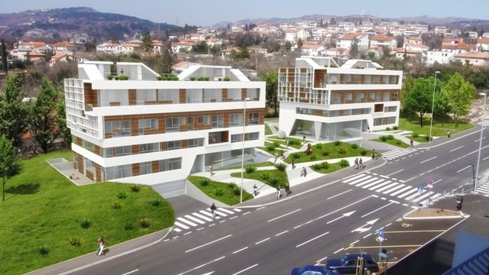
The city of Rijeka
In the city of Rijeka, as a part of the project „Innovative residential construction for the Mediterranean”, two buildings were built near the University campus.

Slide 10
These buildings have A+ energy certificates
A modern design with plenty of space and excellent location
The size of the flats range from 27 m2 to 139 m2
The entire construction and floor plan was done on a higher level
Two heating systems were installed that showed to be highly economical and ecological
Solar panels, placed on the roof, provide warm water and heating
The flats are furnished in a modern interior design with state-of-the-art sanitaries and exterior security doors.

Slide 11
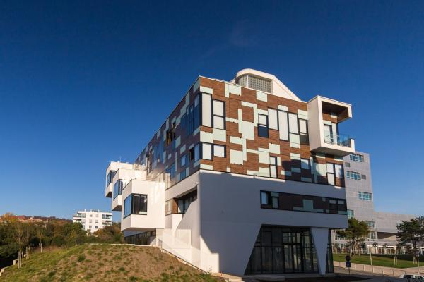

Slide 12
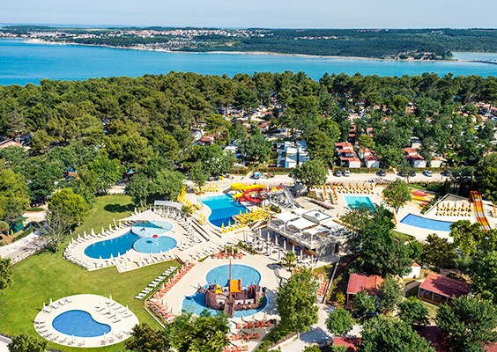
Lanterna peninsula
Large turist complex with hotels, apartment communities and camps

Slide 13
Solar collectors in campsites
Smart security system for electrical energy control and a central system for agriculture
Numerous systems for water filtration
„Grey” water filtration system at campsites,
Oil separator from waste water,
System for recycled heating ,
Remote control system for public water usage.
Separating trash and recycling centers
Filtered water is used in olive groves, where up to 9 tons of olive oil is produced for the needs of the turist complex.

Slide 14
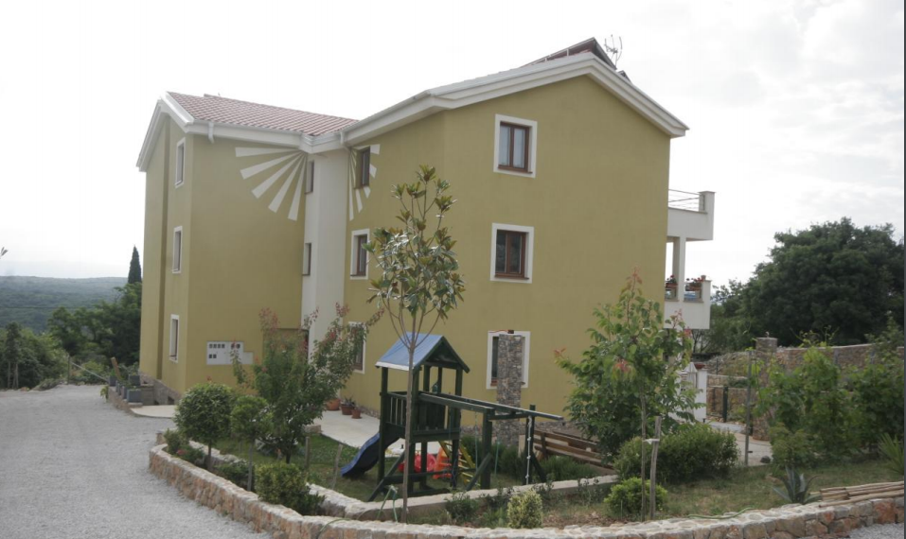
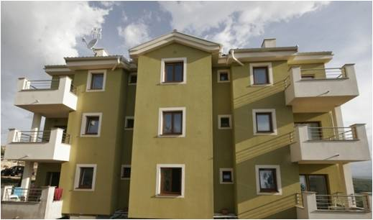
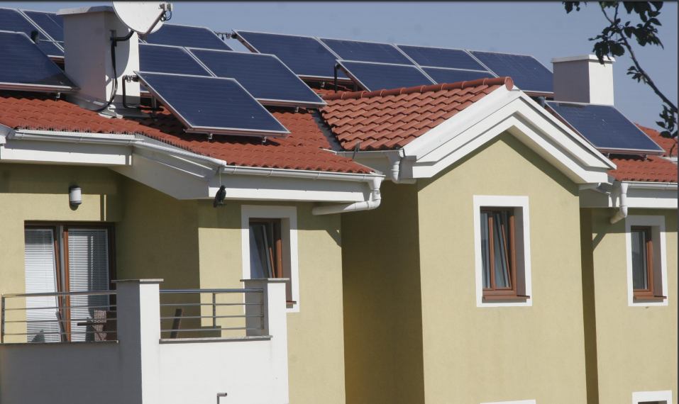
Passive house on the island of Krk

Slide 15
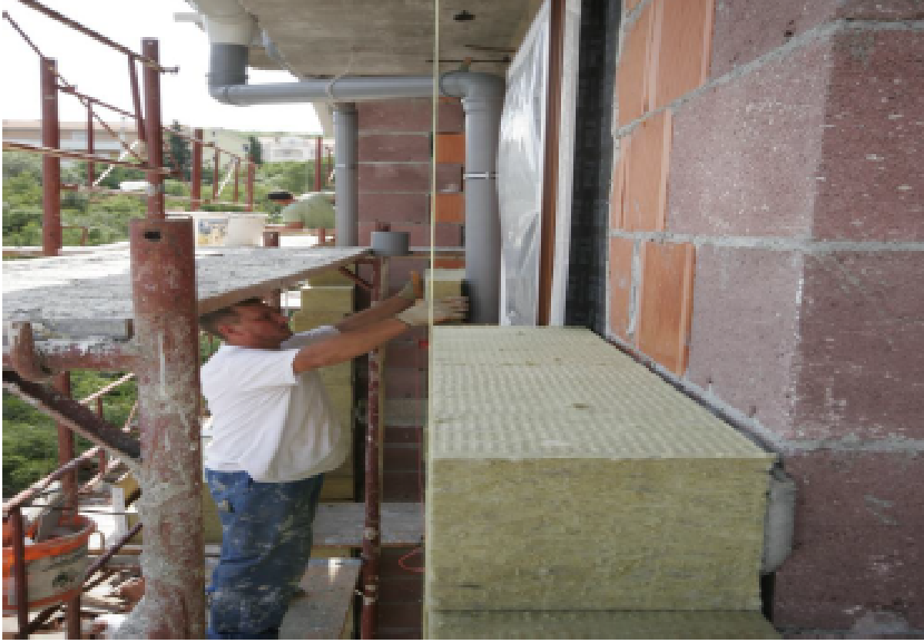
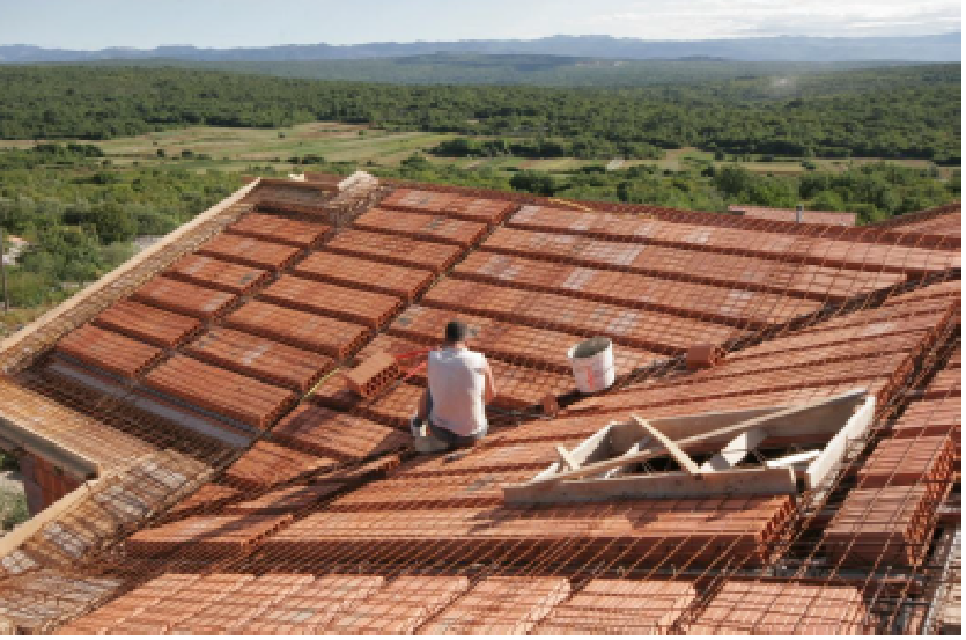
The building as a primary energy source which uses solar energy to heat indoor spaces and water usage.
Two-story building with 6 flats
Double roof and the walls are insulated with rock wool
Windows and doors are made of wood and aluminium
Heating and cooling are generated by a heating pump of air and water
Solar collectors for water and floor heating

Slide 16
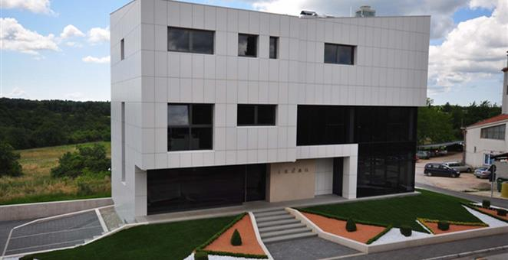
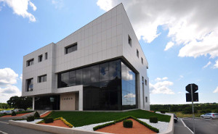
Passive house in Žminj
The building is very unique.
Ecologically-friendly facade, heating and water heating as well as solar panels are part of the passive house
Generating its own electrical energy
Modern LED lightning, modern interior design and „smart house” maintenence system.

Slide 17
The city of Labin
Project SMART ENERGY provides eco-friendly reconstruction of housings
The city of Labin is one of the first to launch this project
The first SMART ENERGY facade was applied in 2005. Until 2014, 34 more building facades have been renewed
The installation of a solar collector system for heating, water heating, thermofacades, roofing and other facilities have been contructed

Slide 18
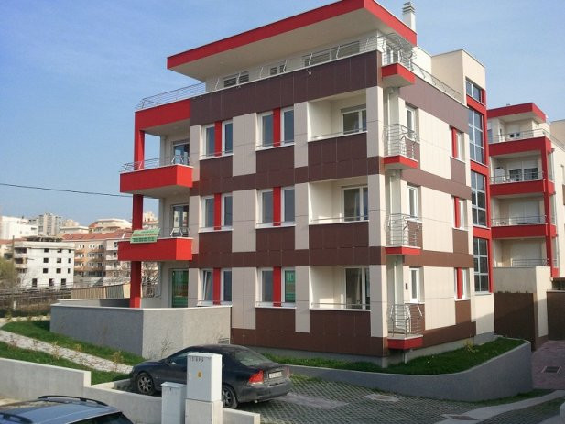
Split – low energy housing

Slide 19
In this urban villa, there are seven luxury suites with an elevator and a private garage.
The living room layout with big bay windows allows for an undisturbed view of the sea.
Energy efficiency and careful financial planning satisfied ecological standards but did not lessen the luxury.
Special care was taken to choosing those building materials that keep out noise and moisture and regulate temperature.

Slide 20
Out-patient clinic in Split

Slide 21
Serves as an out-patient clinic for turists
The energy efficient building and interior are designed for visits in a comfortable atmosphere.
With seven stories and three basement garages, there is an out-patient clinic with doctors’ offices, a microbiological lab, dentist’s and physical therapy facilities.
Luxurious fully-equipt suites with a panoramic view are provided for visitors . There is a library and cinema. A pool is also used for relaxation or therapy.

Slide 22
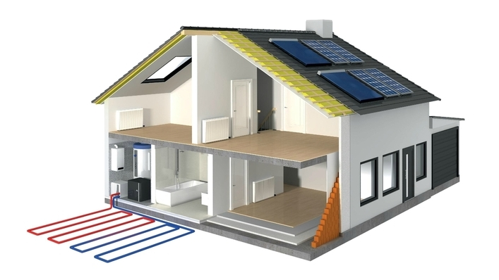
In 2014, The Croatian government came out with a program for energy efficient housing .
The objective of the program was to increase energy efficiency in construction and decrease costs and CO2 emission , and in the end, increasing the quality of life.

Slide 23
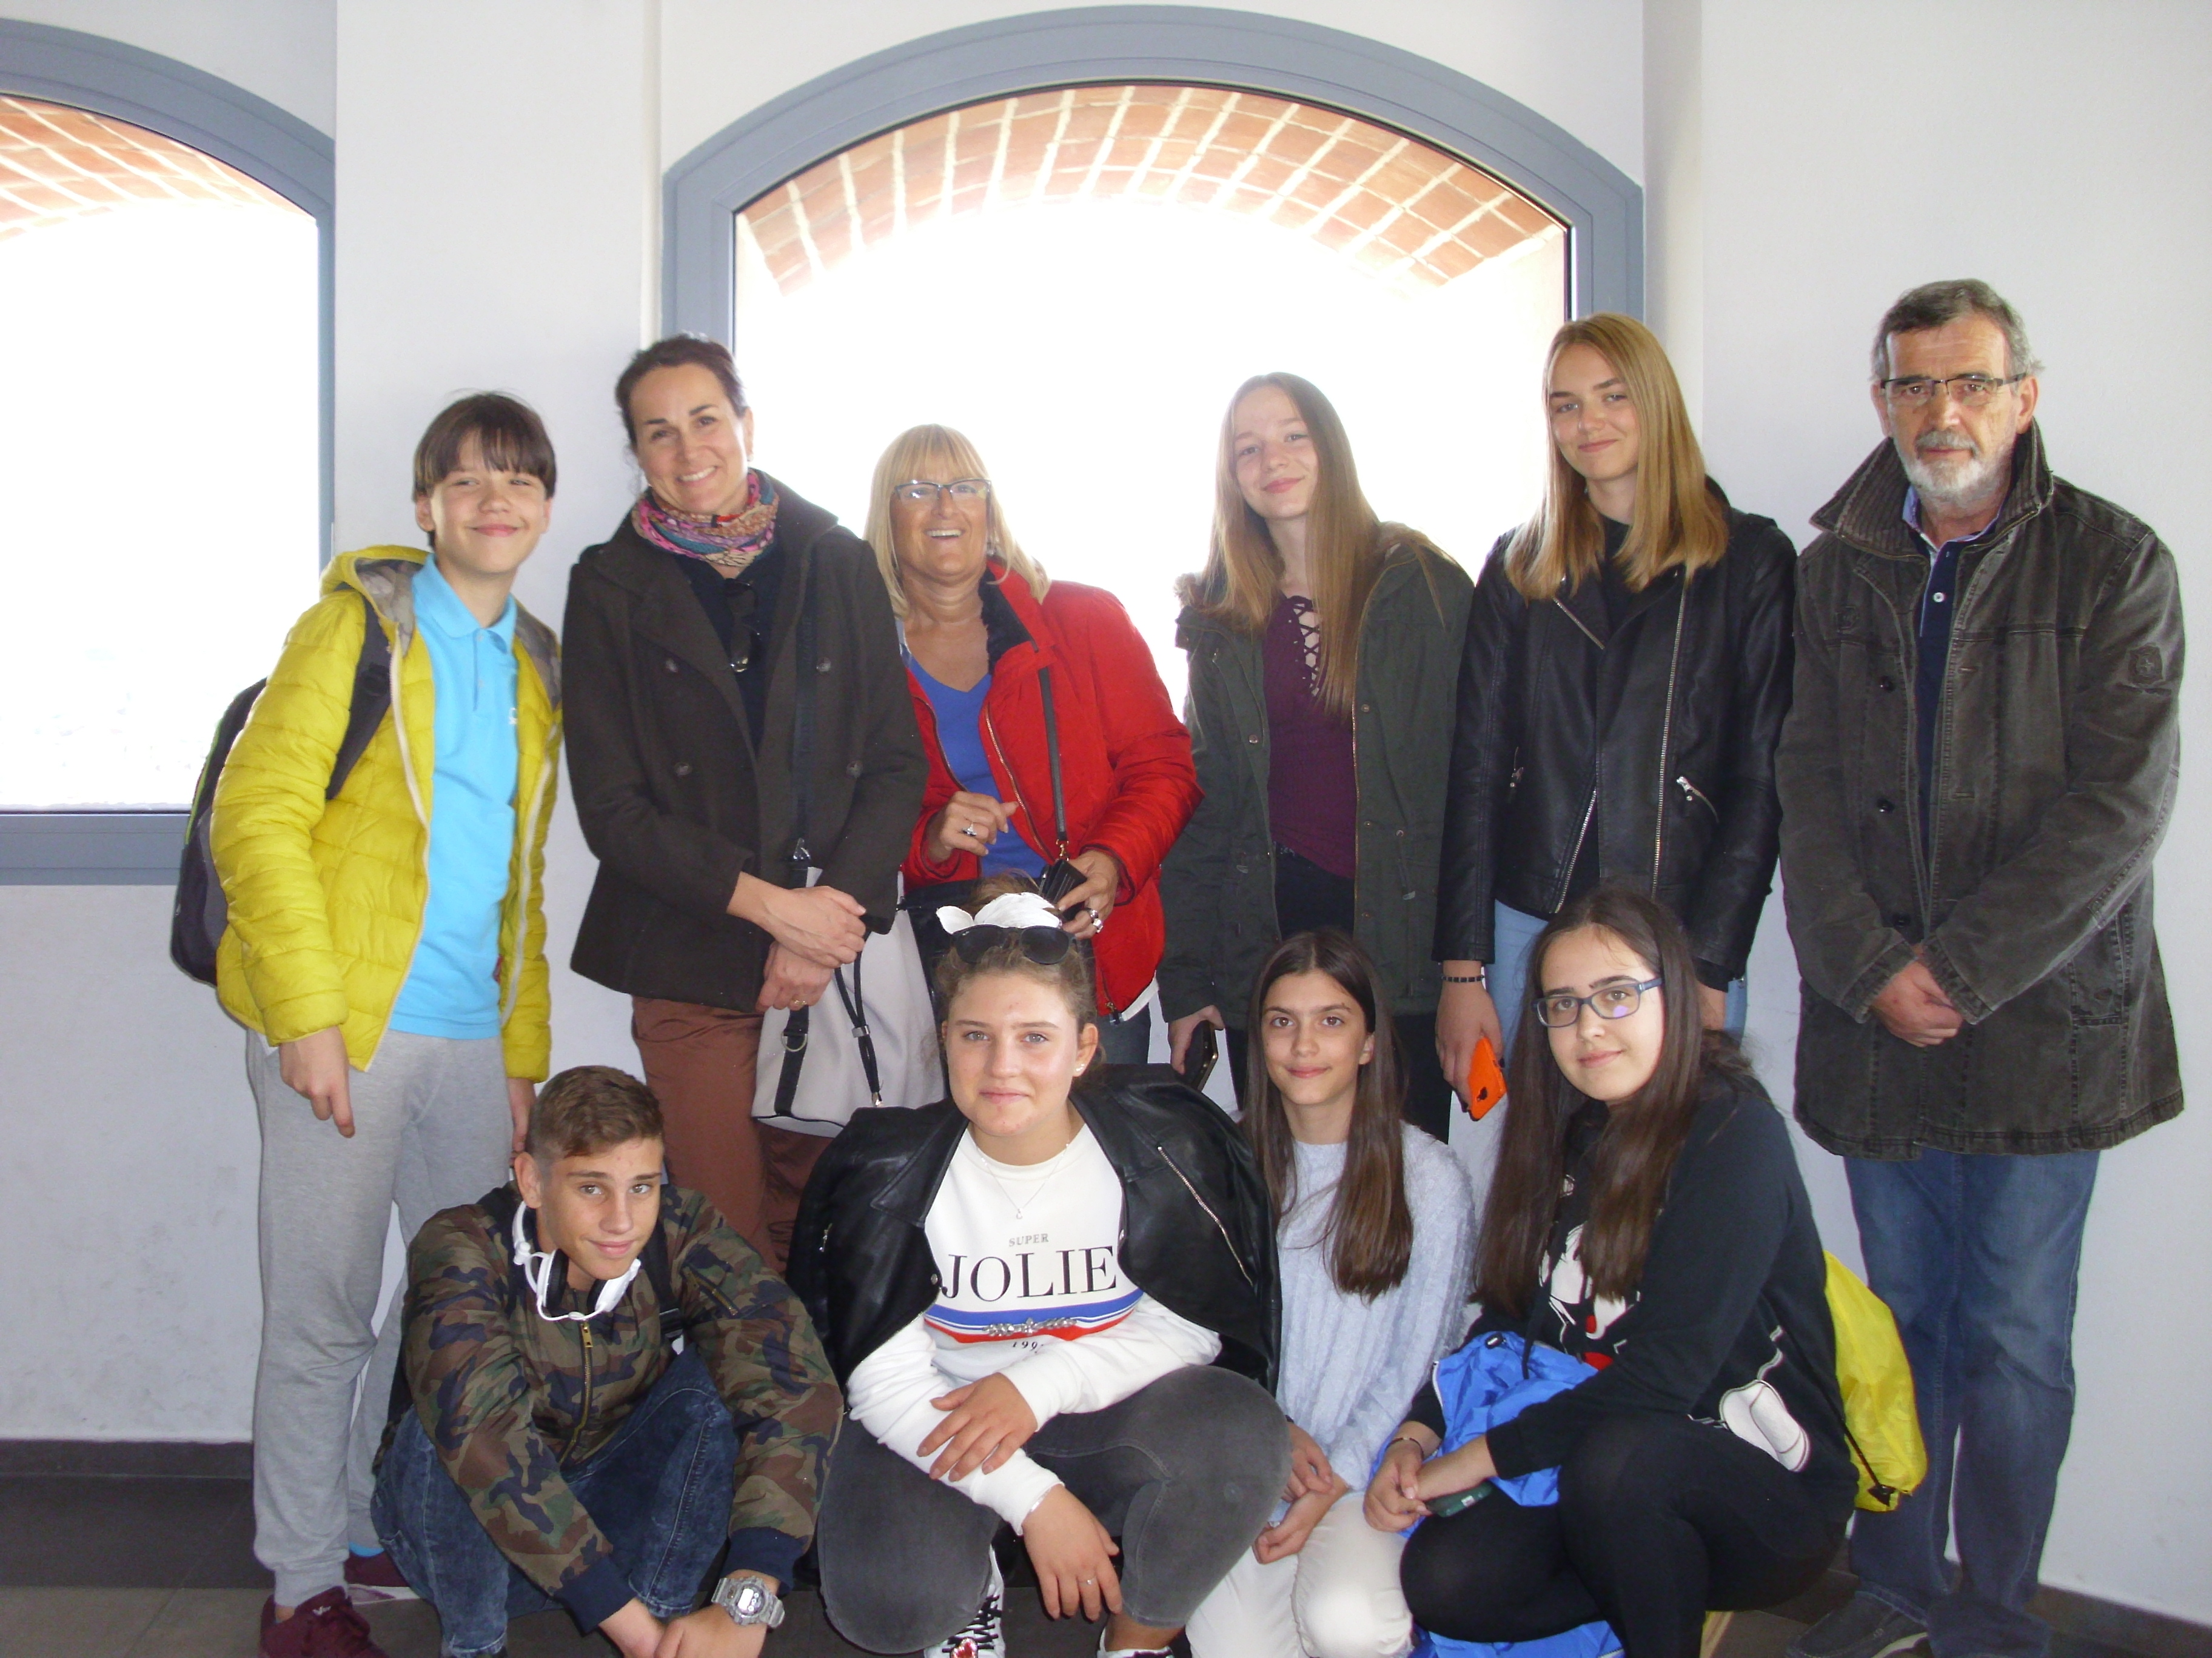
“FUTURE, WORK, HOME- today’s Planning, tomorrow’s Realization”

