Slide 1

My activities
By Mihaela Mihić and Alma Marušić

Slide 2
Introduction
Hello, my name is Mihaela and my name is Alma. In our free time, we are often on my phone. We hang out with our friends, and sometimes we go to sleepovers.

Slide 3
I like to spend time with my friends. We play games like hide-and-seek, tag or we sometime just hang out and chat.

Slide 4
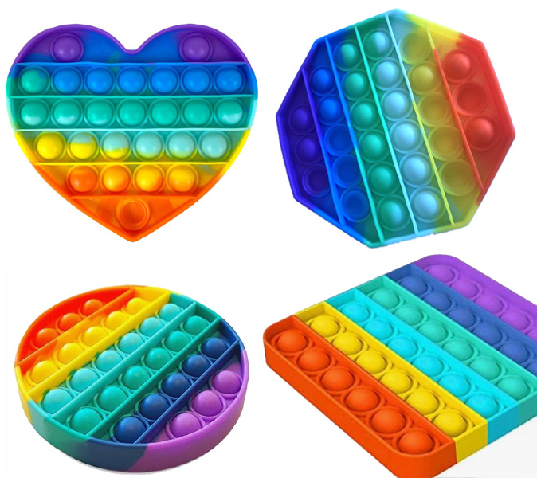
shopping
We like to go shopping and buy many fidget toys like popit. We sometimes go with our friends or with mum.

Slide 5
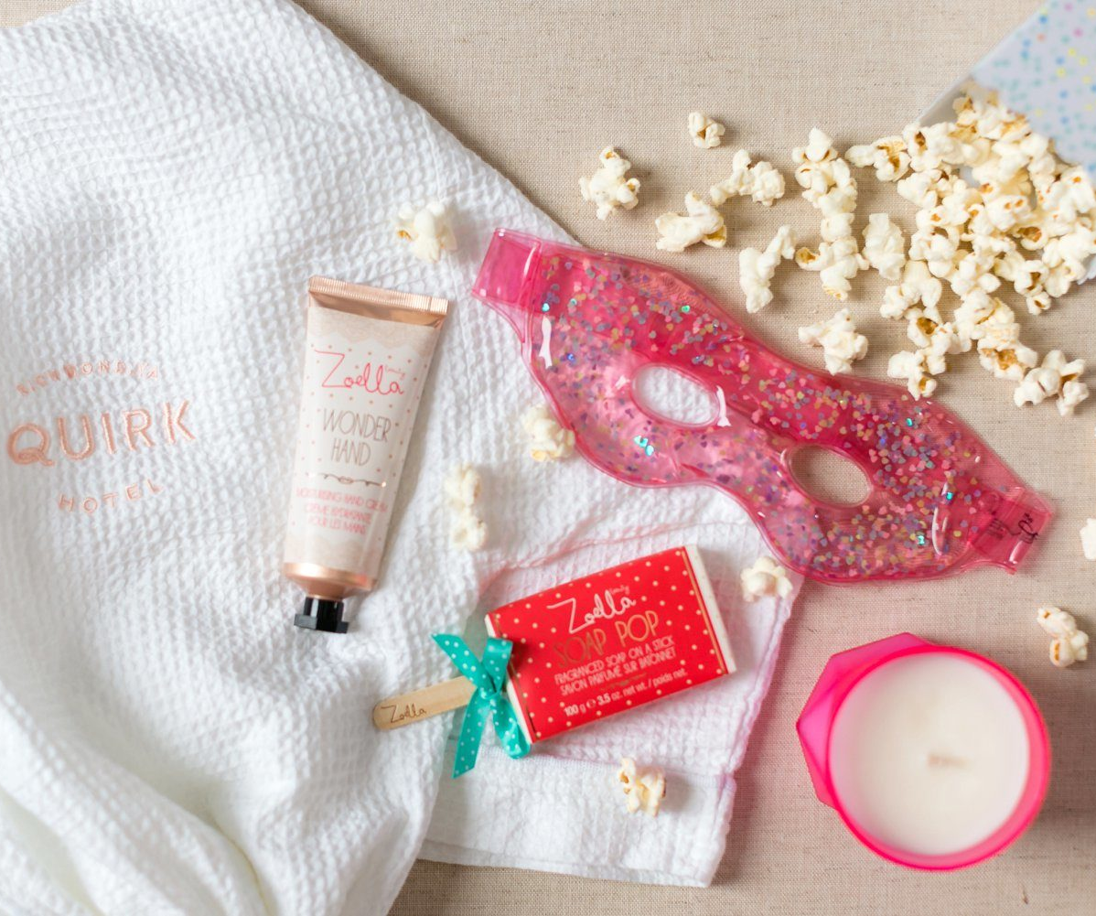
sleepover
We sometimes sleep over at my friends. It is usually afterschool. We play on our phones, watch TV, draw or paint our nails. We have a lot of fun.

Slide 6
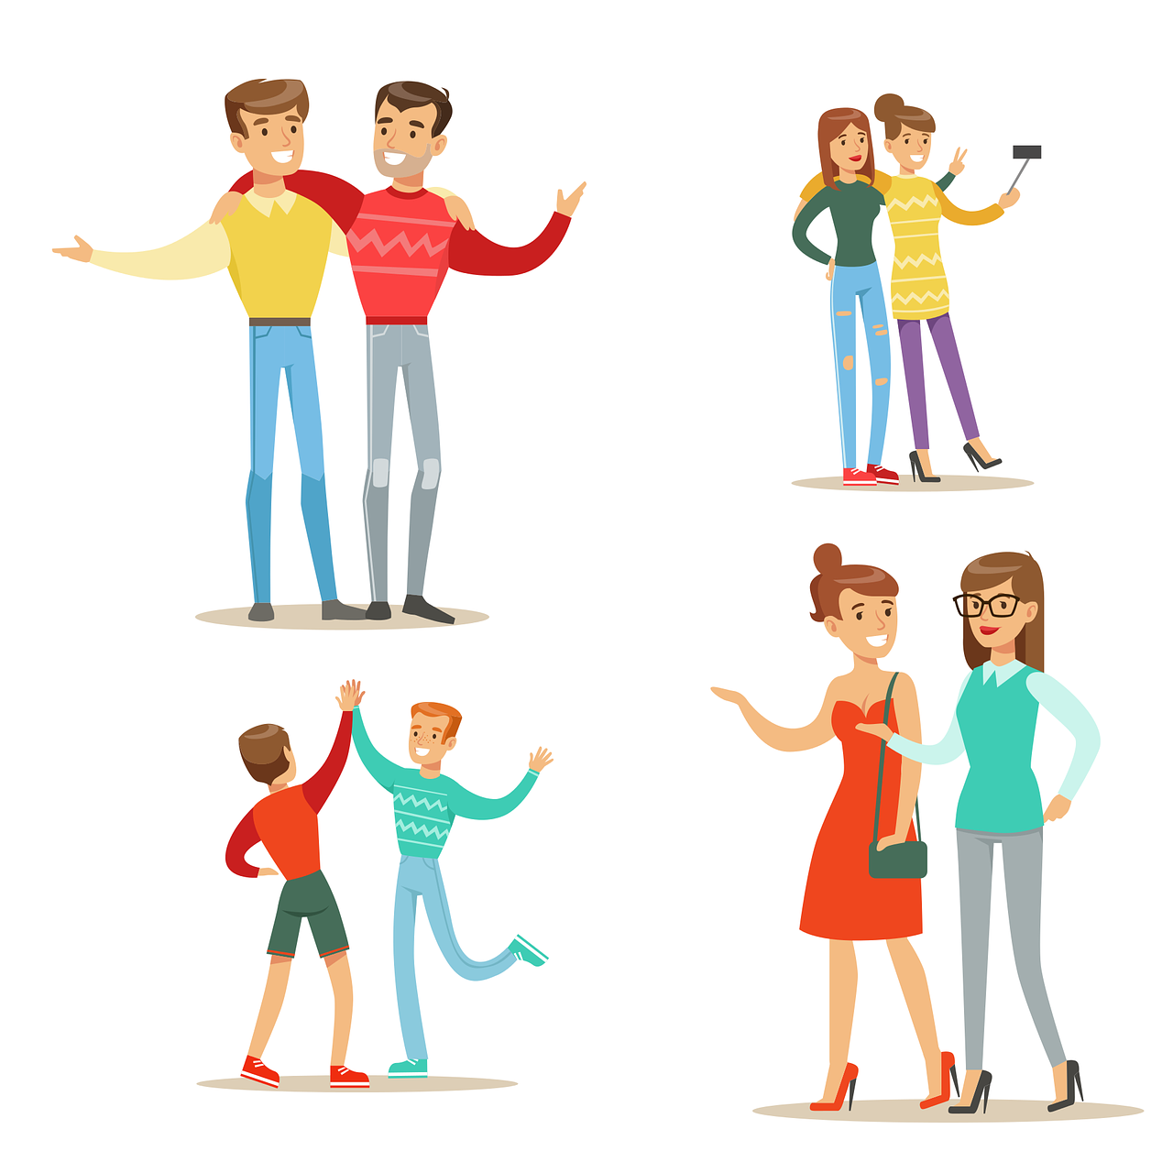
Hanging out with friends
On the weekends we like to hang out together. It is fun.

