Slide 1
Football
Most popular sport in Croatia

Slide 2
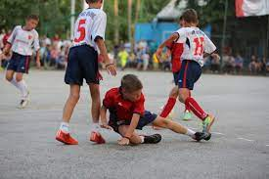
My favourite sport is football.
It is a team sport played with a ball, between two teams of eleven players.

Slide 3
It is a very popular sport. The game is played on a field with a goal on each end.

Slide 4
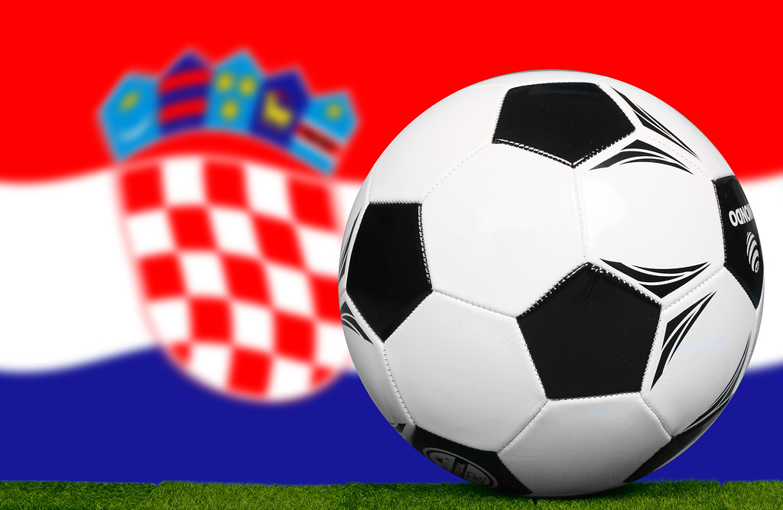
Football
The two teams compete to get the ball in the other team’s goal. Players are not allowed to touch their ball with their hands. Only goal keepers can do that. The team with higher numbers of goals wins the game.

