Slide 1
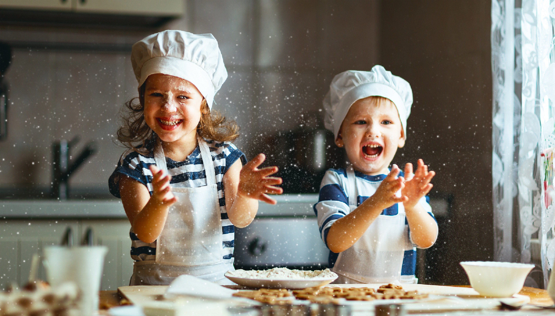
HOBBIES
Marta Bekafigo,Natali Ordulj i Nika Radojković represent…

Slide 2
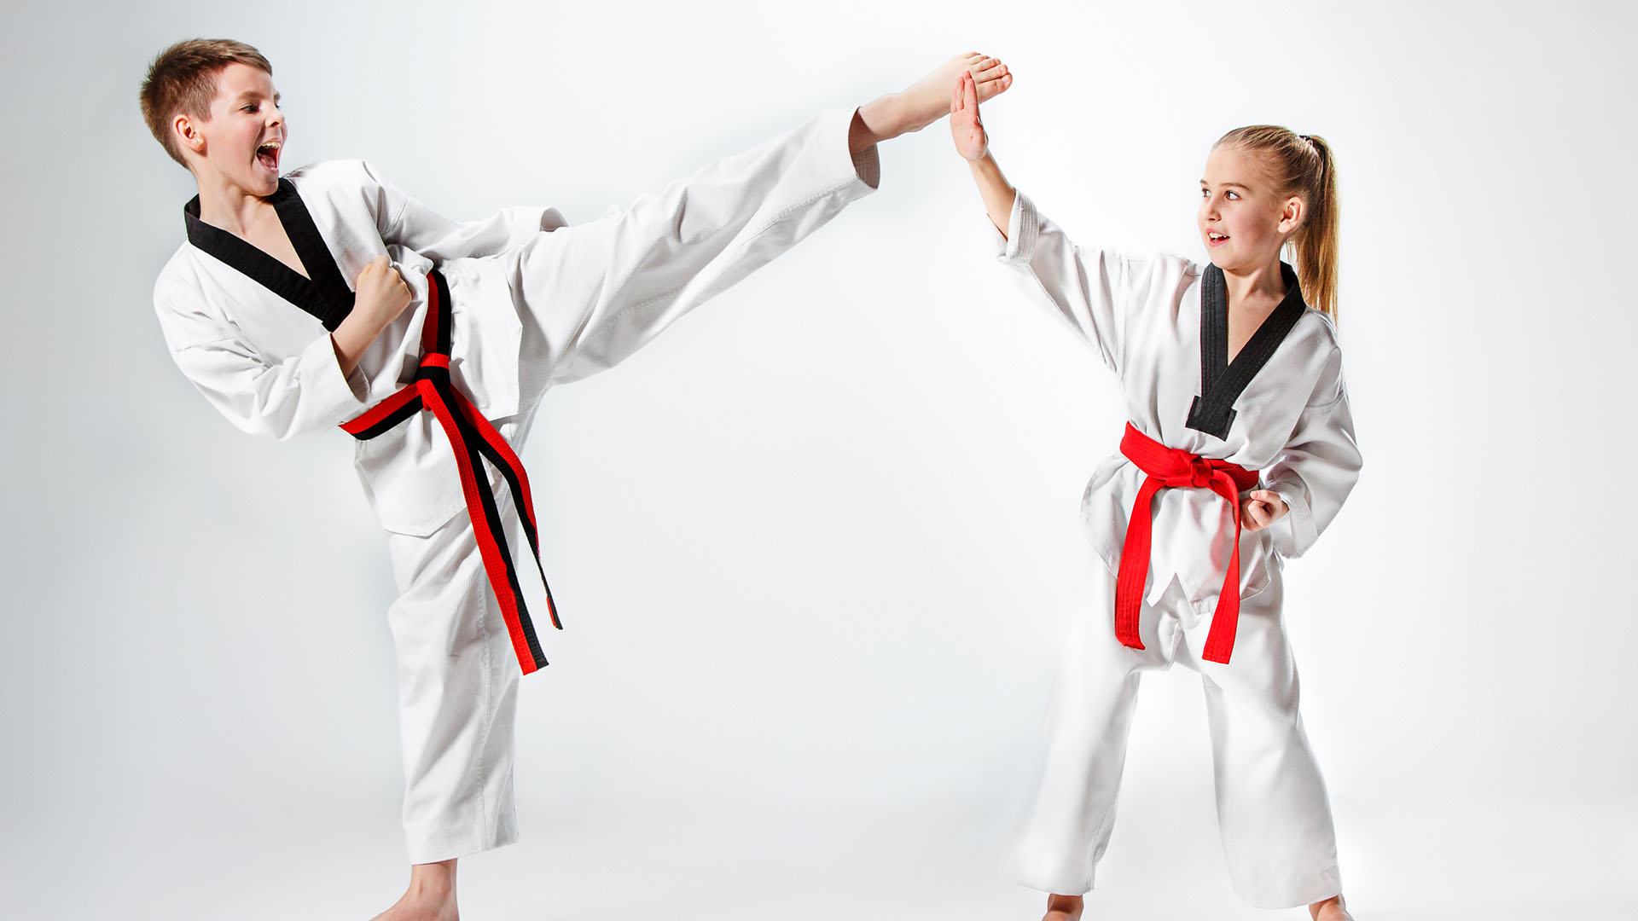
Taek won do
I train taek won do and im very good at it. It is very fun and interactive i learn a lot of new things. Now I have a green belt.I like teak won do.Natali.

Slide 3
DANCE NOA
I train in the dance club Noa. It's fun because we have fun through training. I love my hobby very much. I like my dance Noa.Nika.

Slide 4
MODERN BALLET
I train modern ballet. When I am sad or angry I vent my emotions through dance and music.I like modern ballet.

Slide 5
WHAT I CAN DO AND WHAT I CAN’T DO
Nika: I can play voleyball.
I can’t play basketball because i am not good at that.
Natali: I can play tennis.
I can’t play water polo and I don’t like it.
Marta: I can play basketball.
I can’t play judo.

Slide 6
MY SCHEDULE
MONDAY | TUESDAY | WEDNESDAY | THURSDAY | FRIDAY
MUSIC SCHOOL | TAEK WON DO | MODERN BALLET | ATHLETICS | MODERN BALLET
DANCE | ENGLISH | DANCE | ENGLISH | BASKETBALL
BASKETBALL | ATHLETICS | WATER POLO | MUSIC SCHOOL | TAEK WON DO

Slide 7
I have water polo every Wednesday.
I have dance twice a week.
I have english and music school two times a week.
I have modern ballet two times a week.
I have taek won do twice a week.
I have basketball twice a week.

Slide 8
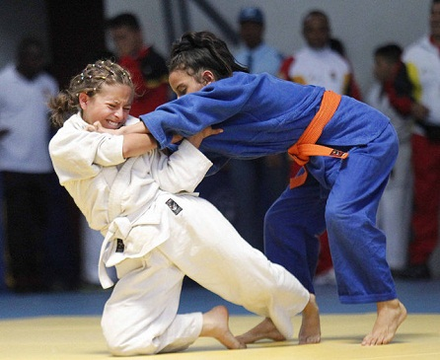
FUNNY Video
https://youtu.be/2mSr6GgQV2Y NOW LOOK THIS FUNNY VIDEO ABOUT JUDO!

Slide 10
THE END
Thank you for watching we hope that you like our presentation.
How do you like it?
a) I like it verry much
b) it is okay
c) I don’t like it
d) I hate it

