Slide 1
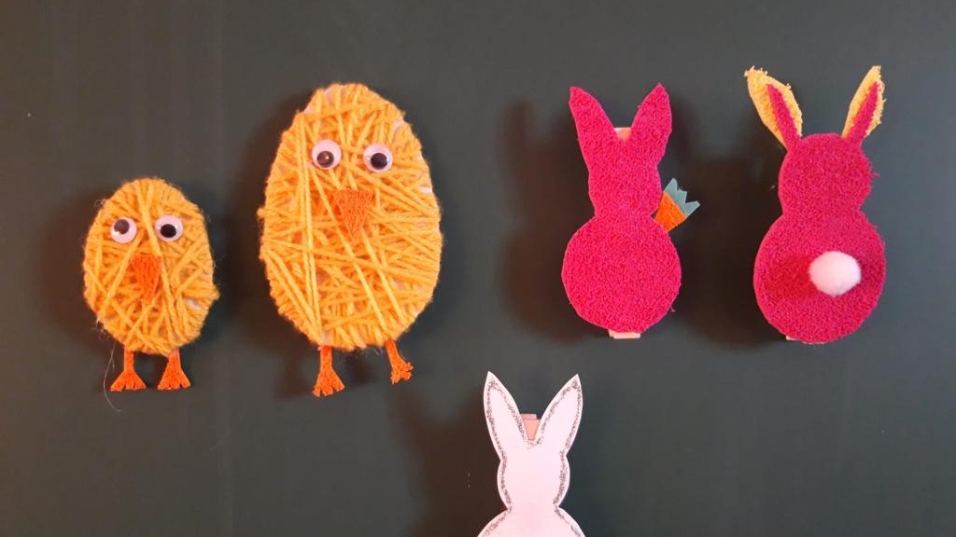
Easter in Croatia

Slide 2
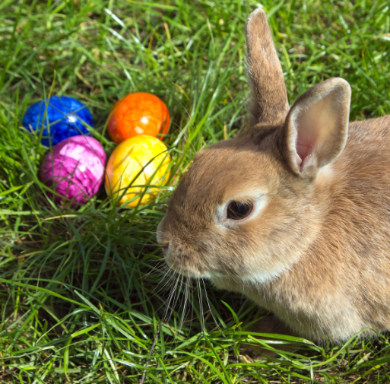
Introduction
Here in Croatia we take Easter very seriously, and as a result there are countless events and special traditions to experience.
Easter is an enjoyable time where families come together to celebrate, eat delicious traditional Easter food and, of course, pay homage to, what Easter is all about, Jesus.
Some may be familiar to you and some may be new, so let's jump right into it.

Slide 3
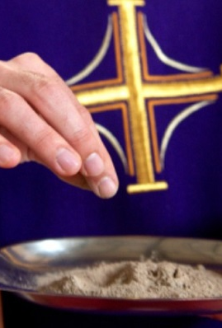
The Christian celebration
Easter is the greatest holiday in Christianity. It is the day when Jesus Christ was resurrected.
The day commemorating his resurrection is celebrated 40 days before Ash Wednesday (Cro. " Pepelnica"). Those 40 days is a time called Lent.

Slide 4
Traditions
Traditionally food is brought to the church on Holy Saturday to be blessed before a massive Easter breakfast.
One of the main traditions of Easter in Croatia is egg dying. In the northwest part of Croatia, these dyed eggs are called "pisanice" or "pisanci" and they symbolise resurrection.
The eggs are colored using hot water and many different additives (examples: leaves, red onion skins, oak or walnut bark, etc.). In this way, you get red- or brown-colored eggs. You can also use other vegetables like beet and parsley if you don’t have any of the given examples.
There were many more egg coloring techniques, but sadly they were lost to the sands of time.

Slide 5
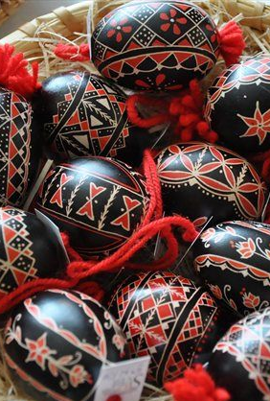
In order to apply the coloring technique, the egg is covered in wax which is peeled off after coloring.
We also use a tool called "Kličica" to make white ornaments and designs on the eggs. Some housewives decorate the egg using a knife and creating intricate details.
Another easter custom called "Matkanje". Before the "pisanice" were prepared as a gift for someone special. The "pisanice" were used for egg fighting (matkanje). A friend would make a statement to strengthen their friendship even more. Because of that, pisanice also have become a symbol of friendship.
To preserve this heritage, the techniques are passed down from one generation to another.
If you would like to try this very traditional and old way of coloring eggs here is a link to a video showing you how: https://youtu.be/voL6B-jJbsU

Slide 6
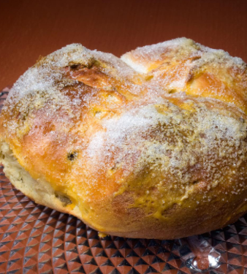
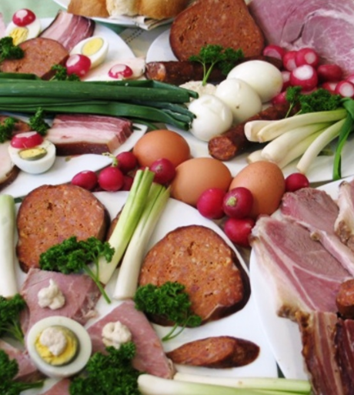
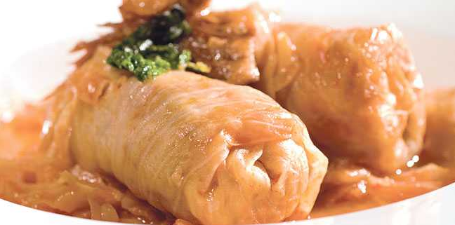
Food
Food is a an very important part when its Easter time in Croatia, especially Easter breakfast where you will find your table spread with a variety of delicious treats.
Here are some examples of food you will see in Easter time: hard boiled eggs, Easter ham, radishes, spring onions, Slavonian bagles, štrukli (a cottage cheese pastry), plaited sweet bread , Easter bread dolls, kuglof ,sirnica (a round sweet bread-like dessert), etc.

Slide 7
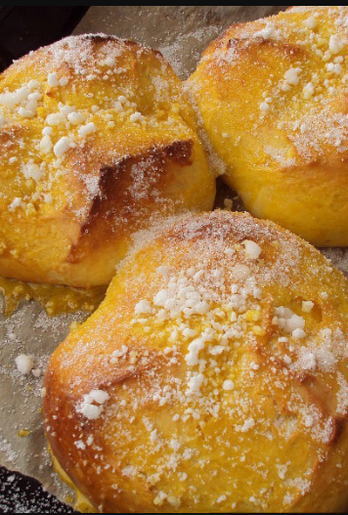
Sirnica
Sirnica is a traditional dalmatian sweet cake which is carved in with a knife.
Sirnica eaten to celebrate the end of Lent, because it contains many eggs. Together with Easter eggs, sirnica has remained the centrepiece of the family Easter breakfast in areas where it is eaten.
Here is a video if you want to make it: https://youtu.be/rfi_cOdZbPs

Slide 8
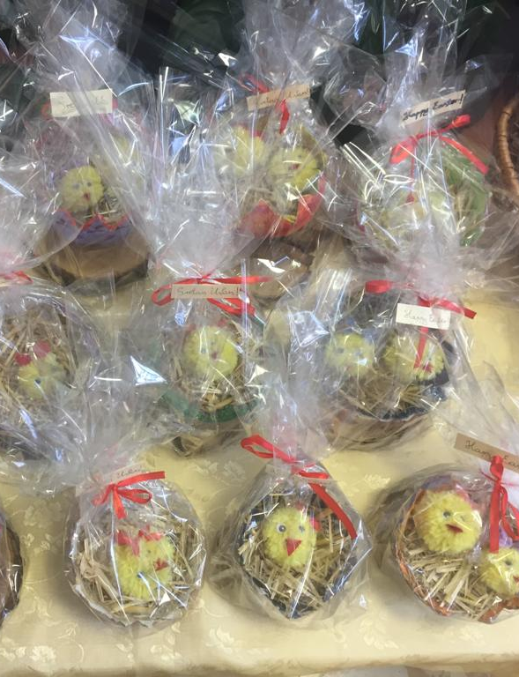
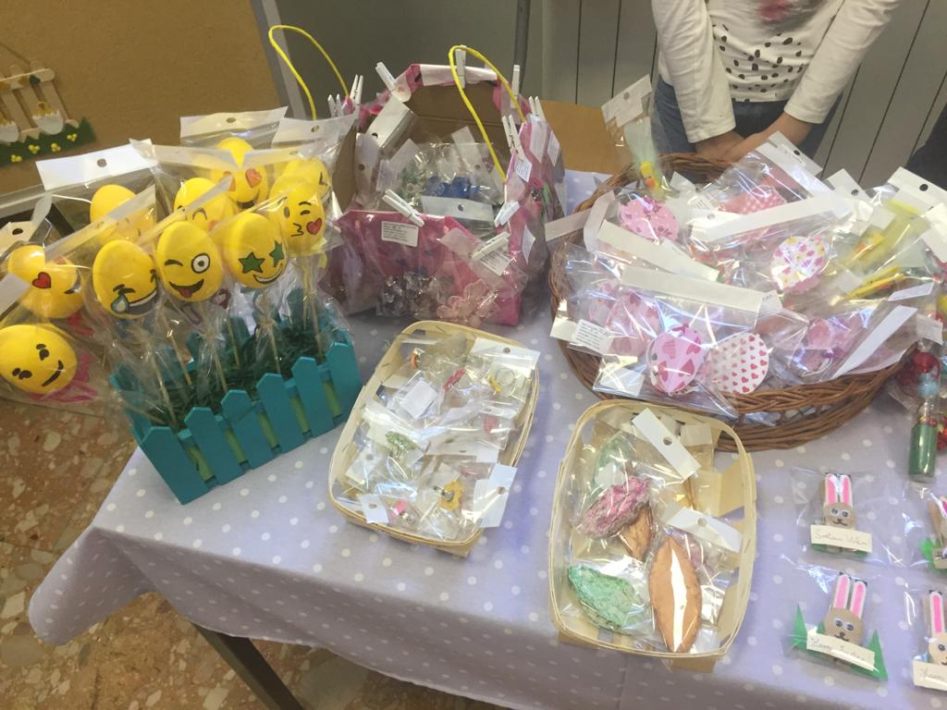
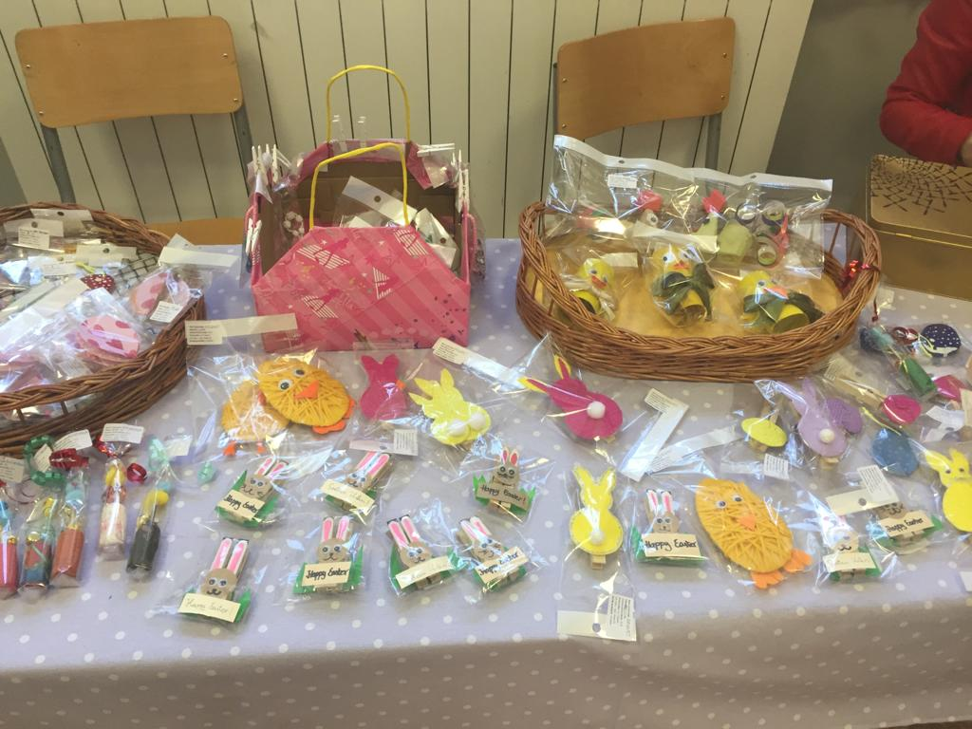
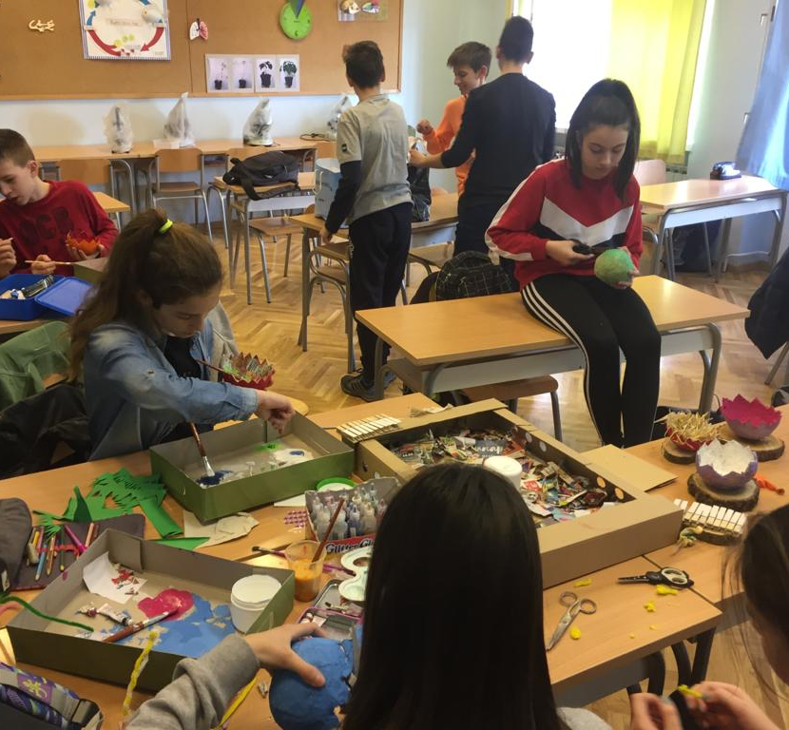
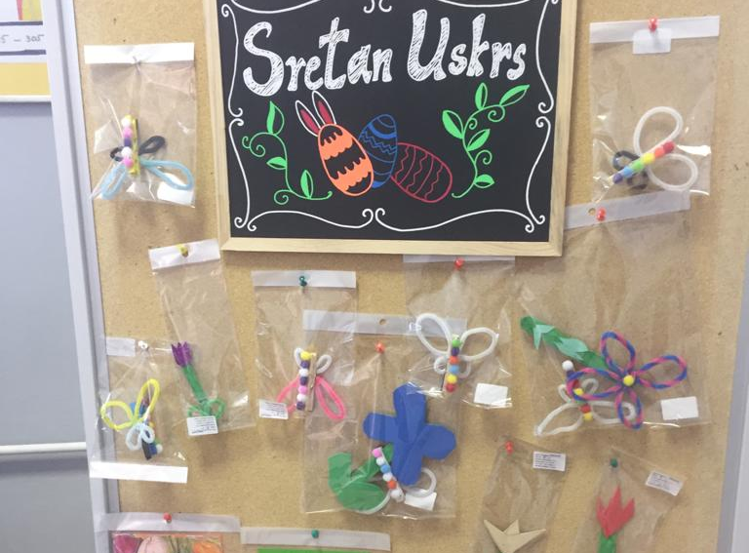
Student works
Two days before spring break, the student body association "Dobrići" organizes a fundraiser of student's artwork to mark the nearing of Easter.
Made by: Dorotea Đeladinov, Marija Tomkić and Marko Kačić

